Slide 1
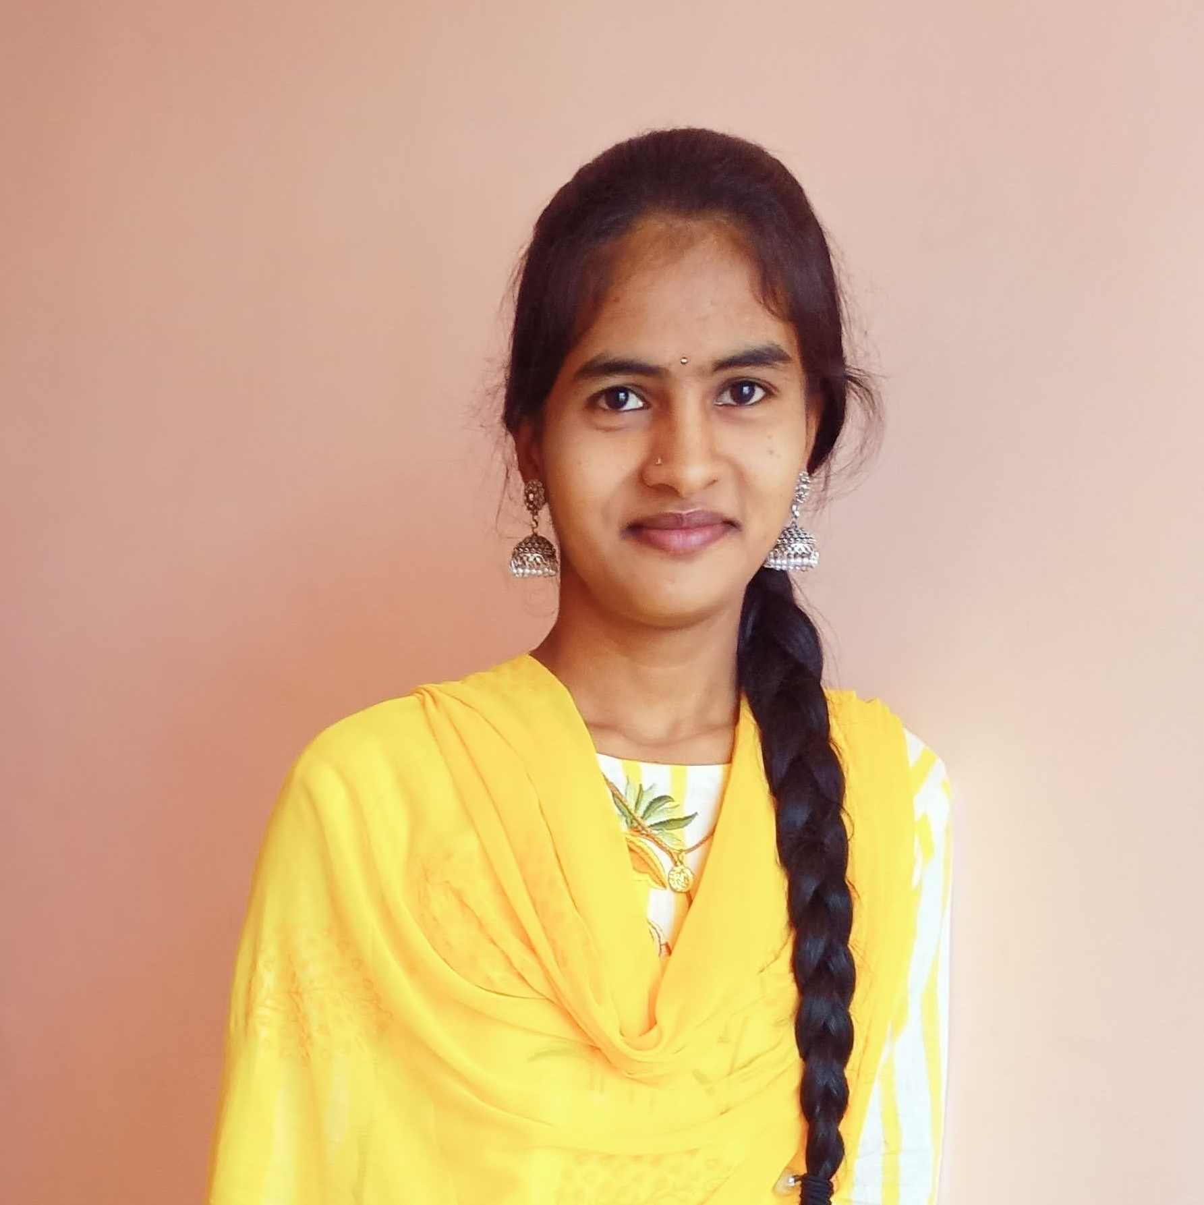



Manisha Yadav Battula
Analyst/Software Engineer
Bachelor of Technology
Computer Science : 2016 - 2020
Skills Java 8 /J2EE
Spring Boot
Spring MVC
MERN Stack
NodeJS
MongoDB
Database
SQL database – MySQL
No SQL database – MongoDB
Web Technologies
HTML5
CSS3
Javascript
AddOns
Github
Maven
Postman
Additional Details
Leadership
Quick Learner
Team management
Bangalore
battula.manisha-yadav@capgemini.com
8897029568
A4
Software Engineer who is Strong in design and integration with intuitive problem-solving skills. Passionate about implementing and launching new projects.
Ready to learn new technologies and implement them to further improve my knowledge.
Eager to work in a team of dedicated people and serve a key role in the enhancement and development of the project.
Has working knowledge on Angular and Java Microservice Development using Spring framework on an intermediate level.
https://github.com/BattulaManisha
E-Commerce Shopping Cart Application
Completed end to end case study of Shopping Cart Application along with JWT authentication, Swagger and payment testing using Braintree in MERN Stack. Material-UI and React Bootstrap used for user interface.
HTML CSS JAVASCRIPT for web developers at Coursera
Completed this course with 98.6% and Designed responsive Restaurant website using HTML5 CSS3 Bootstrap and Javascript
Check out my work on GitHub & Video Profile

